Slide 1

Are you a Cricket fan?

Slide 2


VS

Slide 3
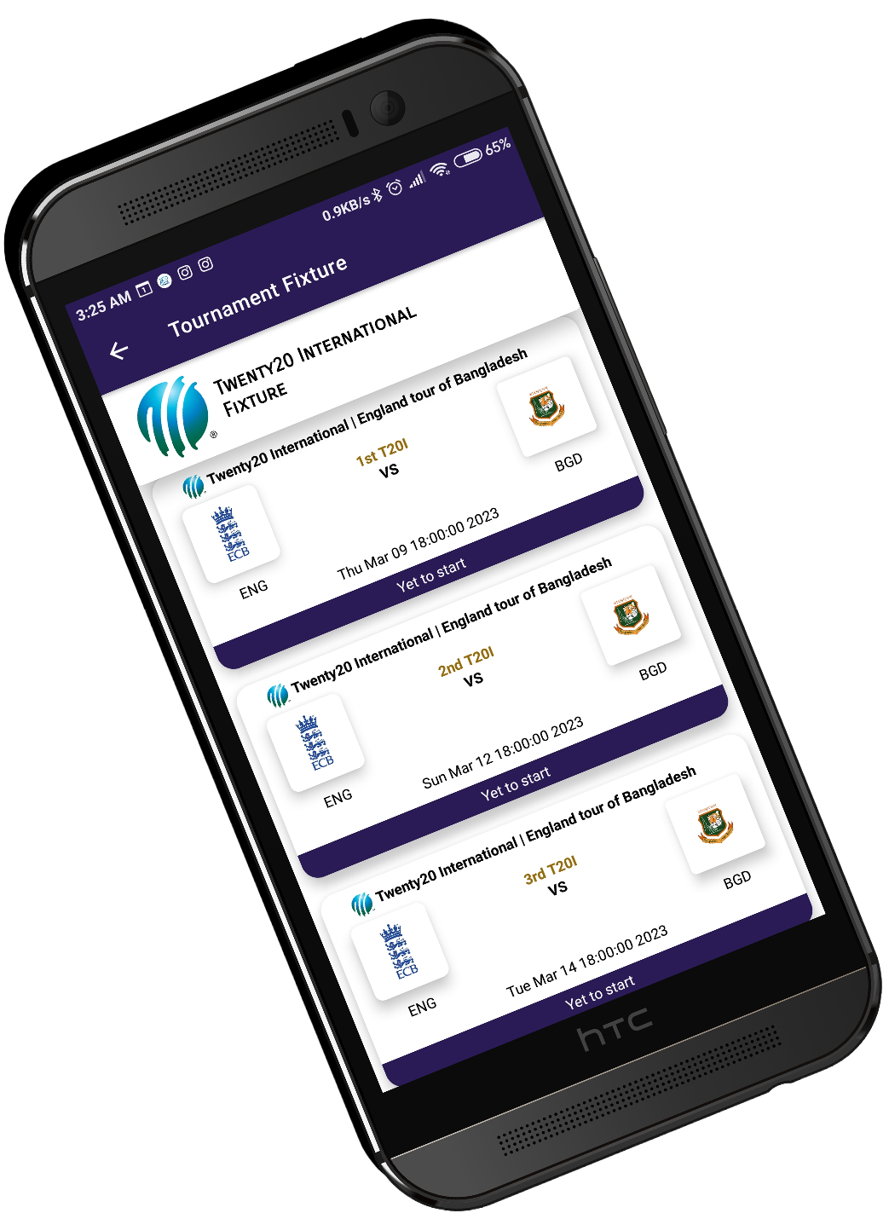

Slide 4

Welcome To The Demonstration of CricVee
Mohammed Moinul Morshed Alvee
ID: T-30031

Slide 5
CricVee
App for Cricket Enthusiasts
Fetches data from API
Caches some data into Local Database
Users can view:
Match Scores
Statistics
Fixtures and more...

Slide 6
CricVee Features
Recent Matches Info
Upcoming Matches Info
Match Push Notifications
Tournament Fixtures
Search Players
Player Profile
Player Career details
Statistics

Slide 7
Technology & Tools used
Operating System: Windows
Software’s Operating System: Android Operating System
IDE: Android Studio
API: Sportmonks Cricket API
Data Storage: SQLite Room Database
Programming Language: Kotlin
Debugging & Testing: Android Studio Debugger tool
UI Designing: XML
Libraries: Retrofit2 , Moshi, Room Database, Material Design and Navigation component

Slide 8
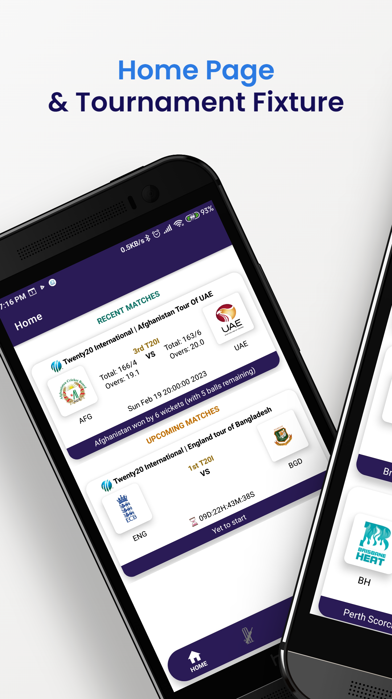
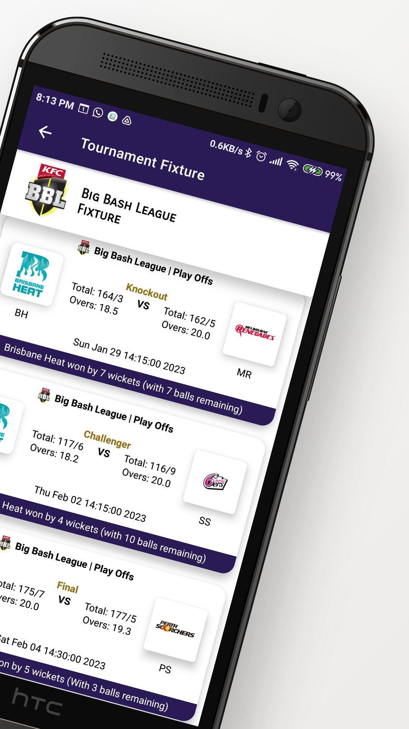
UI Screenshots

Slide 9
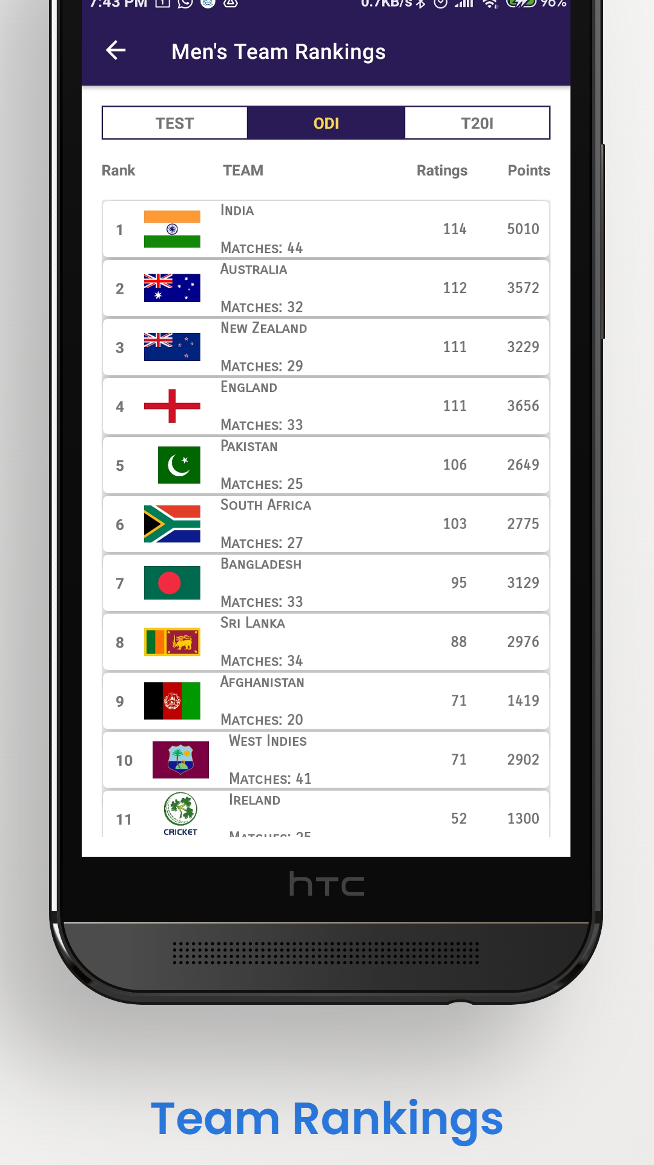
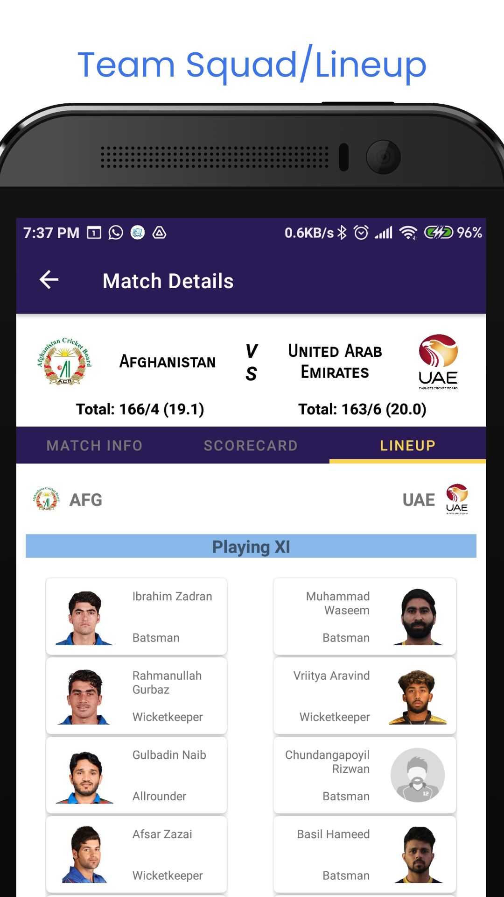
UI Screenshots

Slide 10
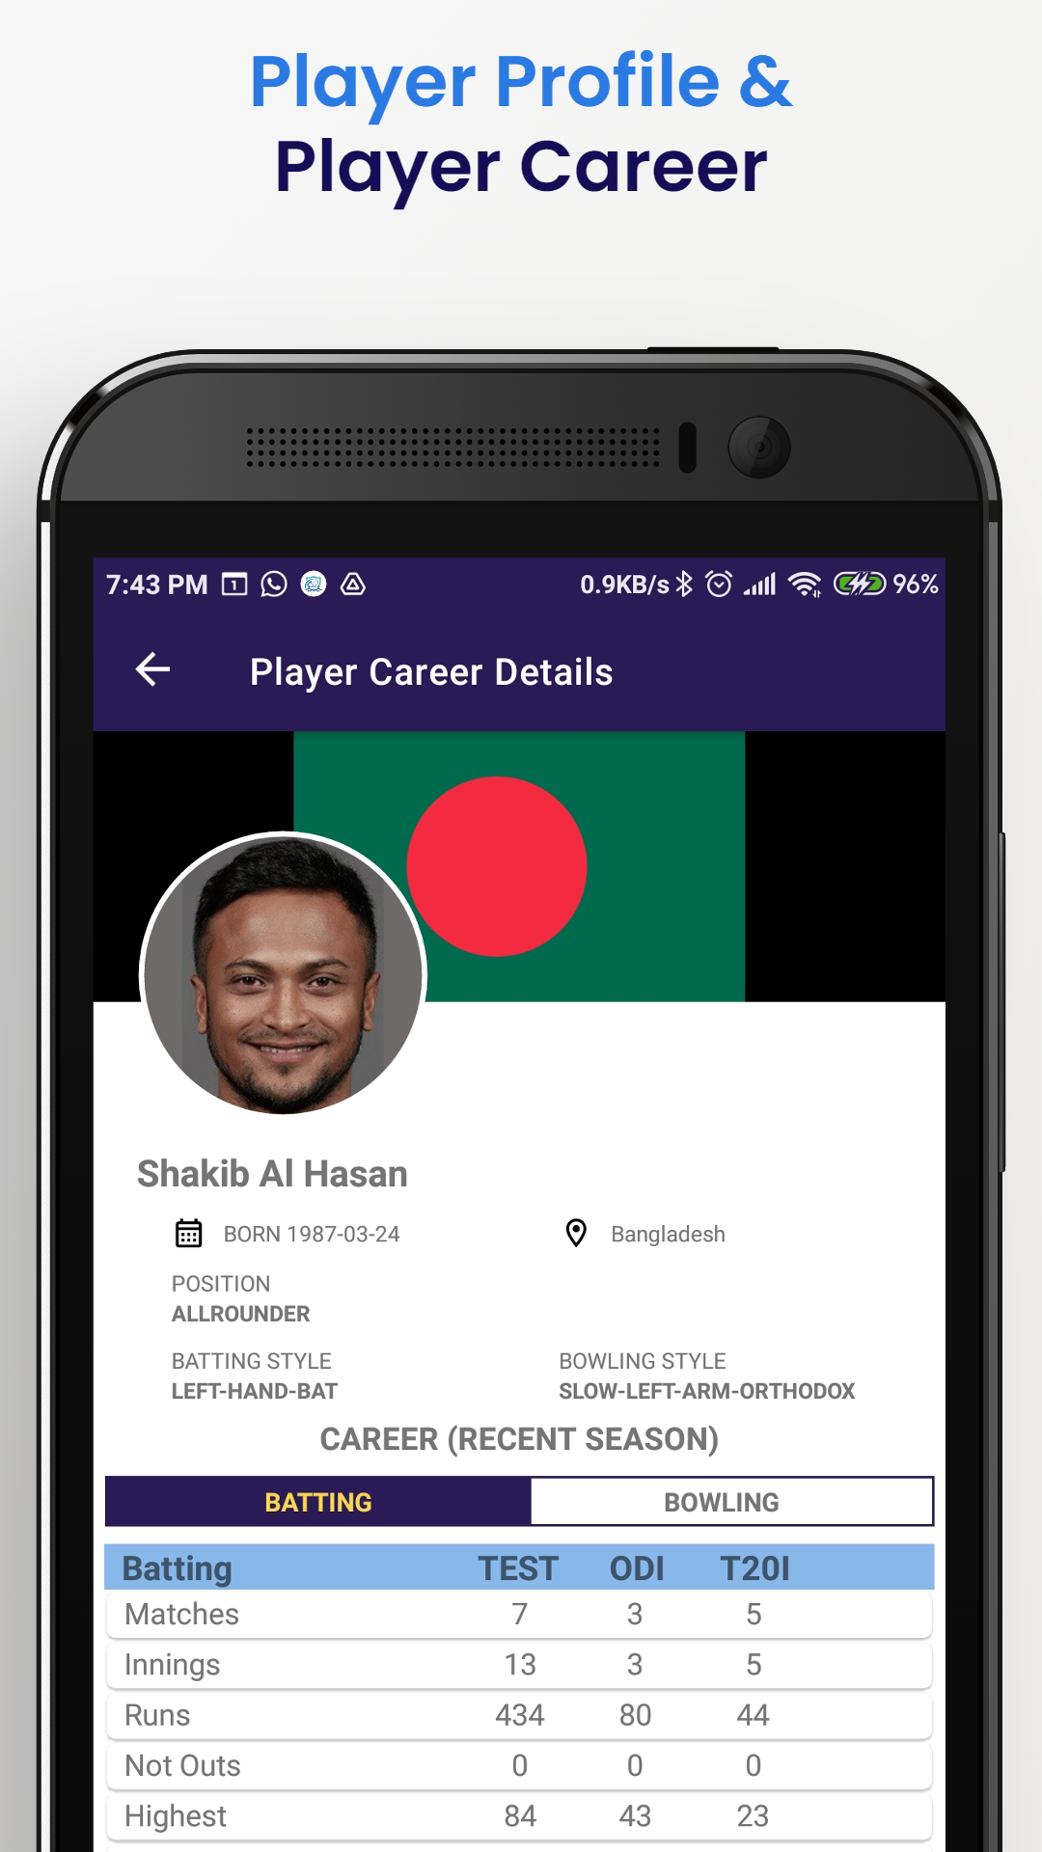
UI Screenshots

Slide 11
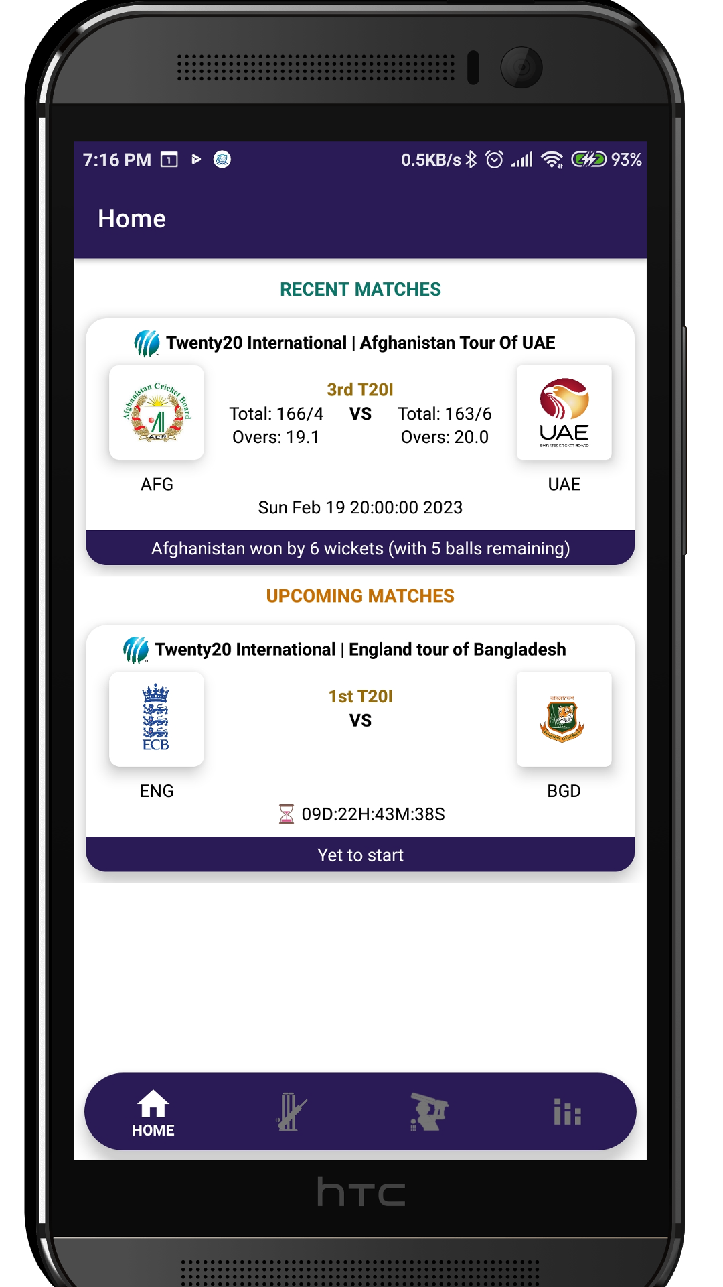

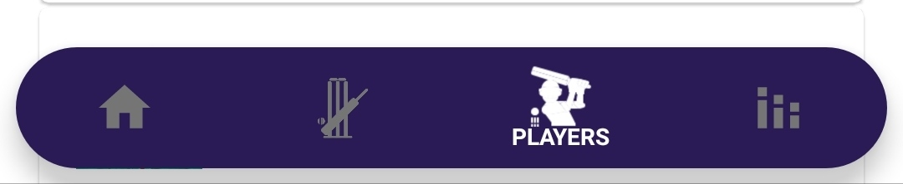

Home Page
Match Summary:
Match League & Stage
Recent Matches
Total Scores
Match Time & Date
Upcoming Matches
Live Countdown

Slide 12
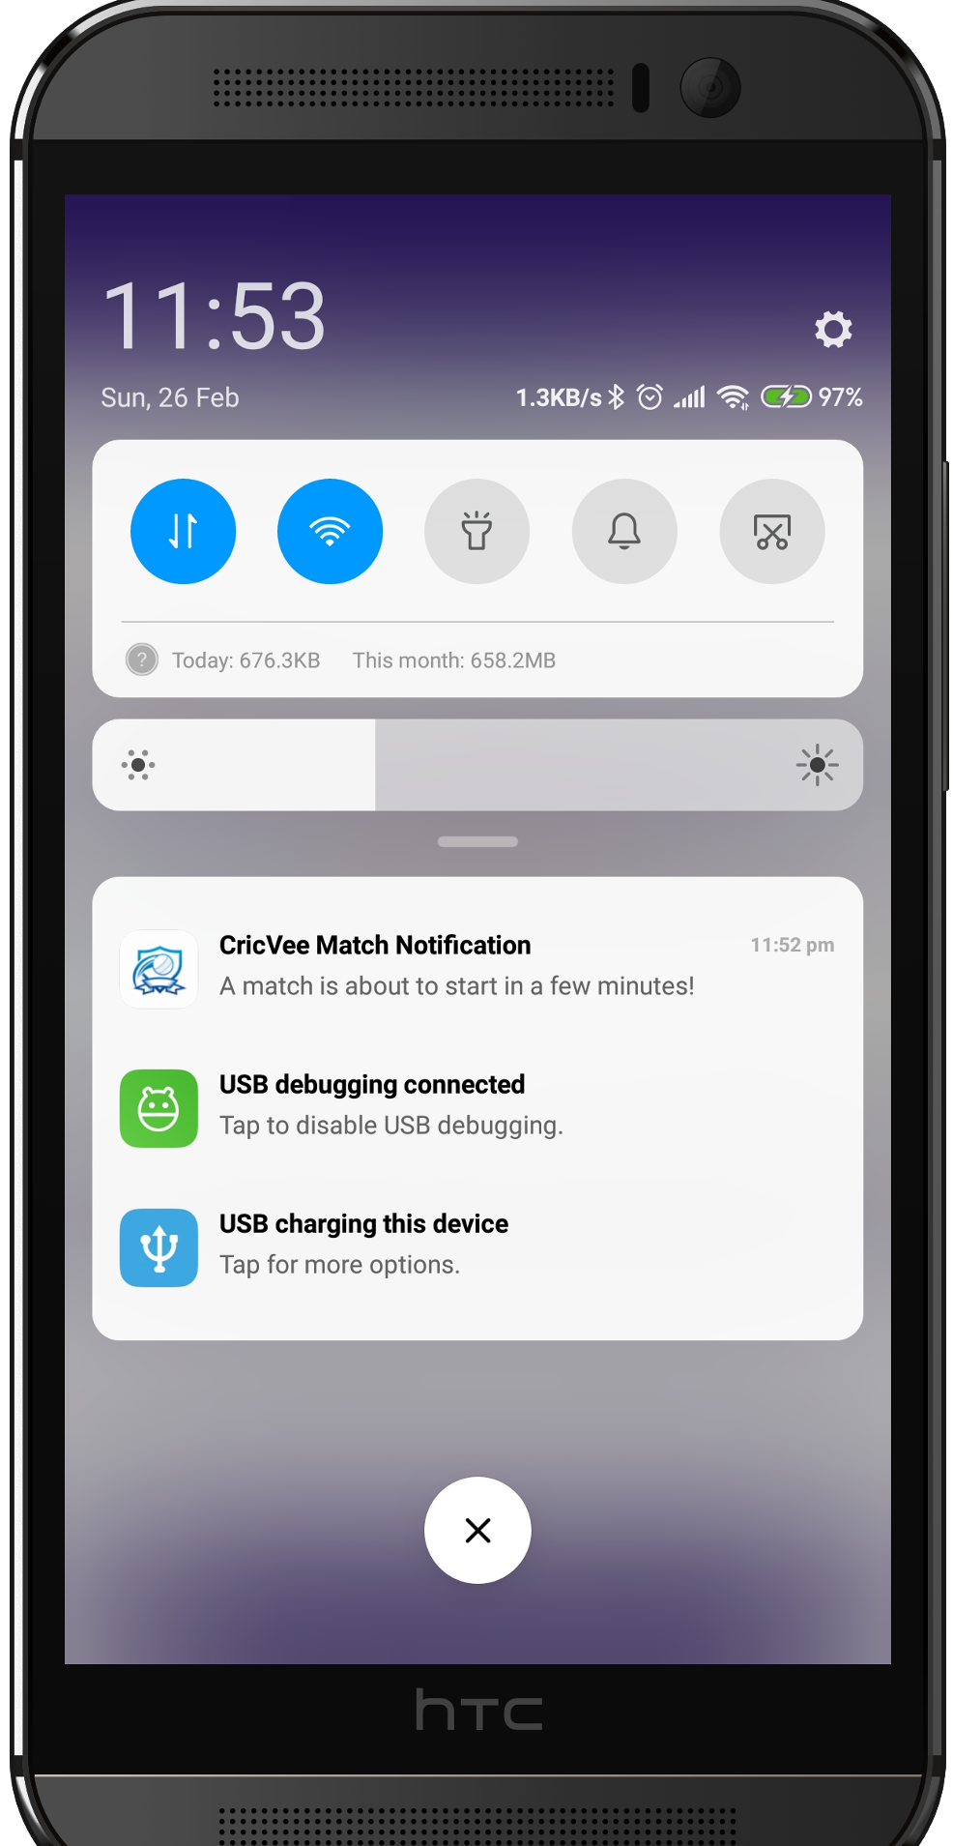
Match Push Notification
Notifies the user
15 minutes before a
match starts

Slide 13
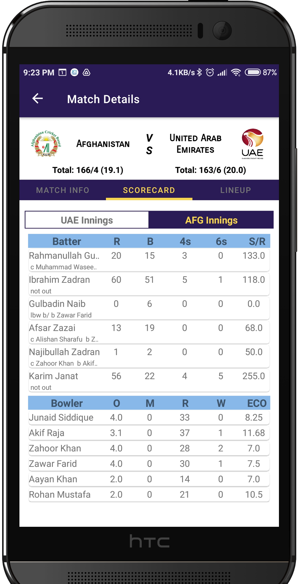
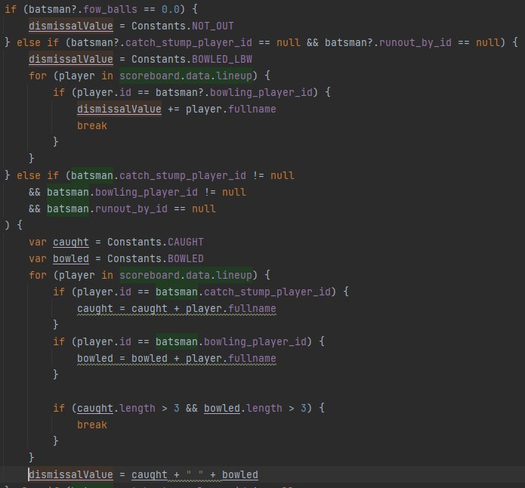
Match Scoreboard Calculation

Slide 14
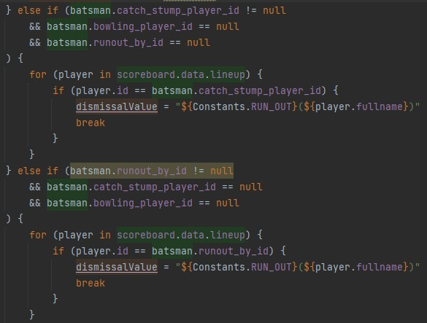
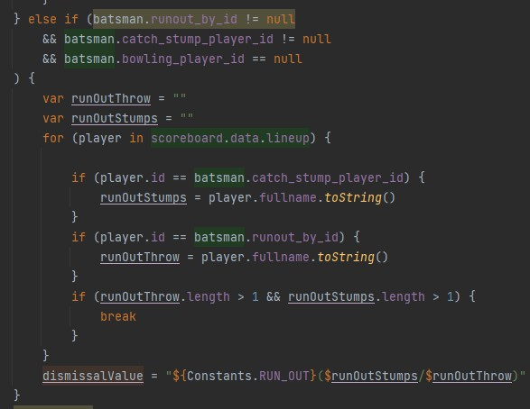
Match Scoreboard Calculation Part 2 & 3

Slide 15
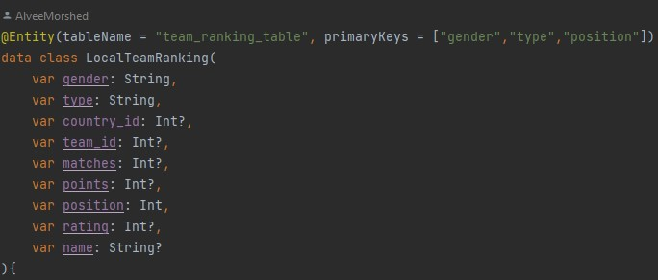
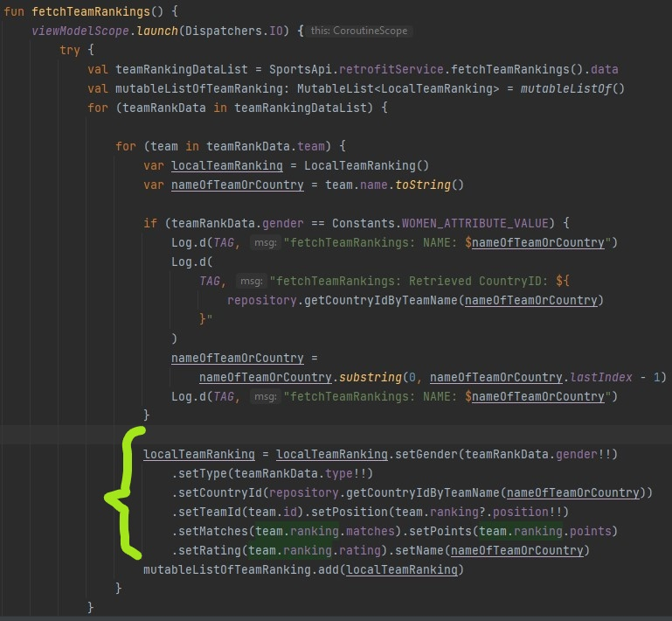
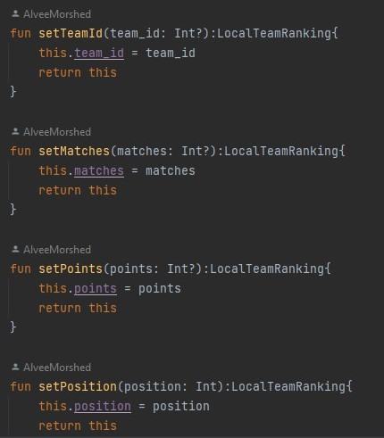
Team Rankings Caching
Implementation of Builder Design Pattern
Data Class
Builder Pattern Designing
Utilizing the Builder Pattern to Cache into DB

Slide 16
Learnings
Implementation of Singleton, Builder and Adapter Design Pattern
SDLC
Task Management
Clean Coding

